Slide 1




Slide 2


Predicting Virality of Youtube Videos

Slide 3
Topics
Problem / Objective Statement
Tools Utilized
Data Collection / Prepreocessing
Visualize the Data / Hypothesis Testing
Numeric Modeling
Text Preprocessing
Text Visualizations
Text Modeling
Final Combined Numeric + Text Modeling
Conclusion / Next Steps

Slide 4
Problem / Objective Statement
Marketer Perspective:
Increase brand awareness and reach 10M views within 16 months months based on information from Google API video features
Optimize user feeds by pushing viral videos only
Optimize pricing strategy to charge more for viral videos
To prevent view count hacking, utilize a model to predict whether hacking is occurring.
Create a supervised learning model with 60-70% accuracy.
Youtube Perspective:
Objective:

Slide 5
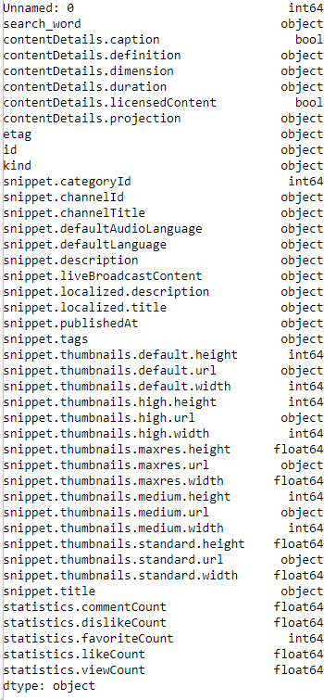
Data Collection / Preprocessing
Youtube Search Words
siemens, Cats, laugh, speedrun, minecraft, music, gaming, sports, dude perfect, donald trump, golf, iphone, mac, Christmas, mars, horror, vacation, video blogging, movies, python
contentDetails – content of video details (i.e. length, captioned) (numeric)
snippet – Object that contains details about the video (text)
tags – A list of keywords associated with a video (text)
statistics – (numeric)
Source: https://developers.google.com/youtube/v3/docs/videos
Addressed NaN by using mean for numeric data
Converting time data into age
Removing unnecessary features using common sense and hypothesis testing
Brief Explanation of Data
Preprocessing

Slide 6
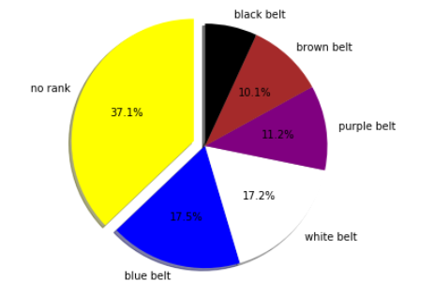

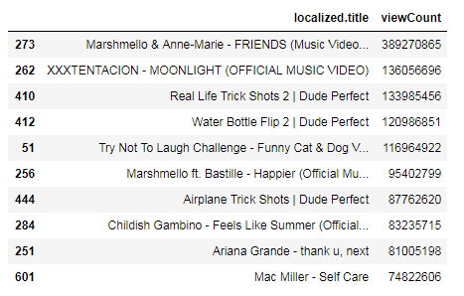
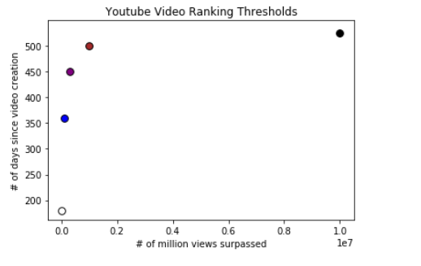
Target Data / Belt Ranking System
Top 10 Black Belt Videos

Slide 7
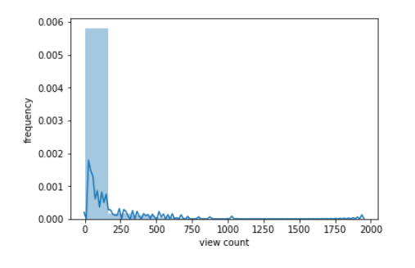
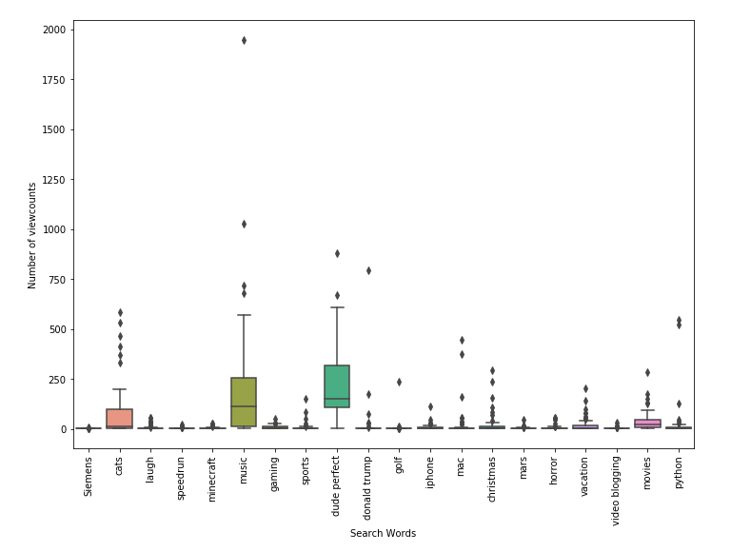
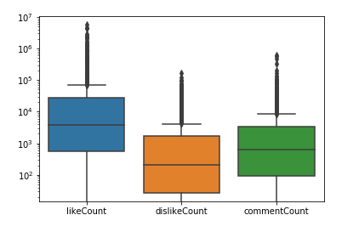
Visualization - View Count Frequency

Slide 8
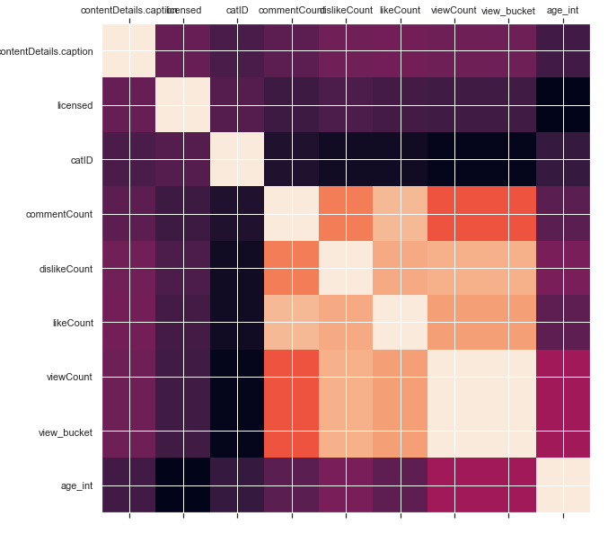
Correlation Graph of Selected features

Slide 9
Numeric Modeling Results
Model | Parameter / Notes | Accuracy
Linear Regression |  | 0.07
Logit - C hyperparameter tuning | Convergence problem when tuning C: Analyzed data, C, and increased max_iter. Decided to not pursue further | 0.3737
SVM |  | 0.4242
Logit |  | 0.44
KNN | Tested nn range 1-20, best =3 | 0.5252
Decision Tree Classifier |  | 0.5959
Gradient Boosting - default |  | 0.6464
Gradient Boosting - random search | {'n_estimators': [100, 311, 522, 733, 944, 1155, 1366, 1577, 1788, 2000], 'max_features': ['auto', 'sqrt'], 'max_depth': [2, 2, 3, 4, 5, 6, 6, 7, 8, 9, 10, None], 'min_samples_split': [2, 5, 10], 'min_samples_leaf': [1, 2, 4]} | 0.6565
Gradient Boosting - grid search | {'max_depth': [30, 40, 50, 60, 70], 'max_features': [2, 3], 'min_samples_leaf': [1, 2, 3], 'min_samples_split': [2, 3, 4, 5], 'n_estimators': [100, 200, 300, 1000] } | 0.6666
Random Forest - default |  | 0.6869
Random Forest - random search | {'bootstrap': True, 'class_weight': None, 'criterion': 'gini', 'max_depth': None, 'max_features': 'auto', 'max_leaf_nodes': None, 'min_impurity_decrease': 0.0, 'min_impurity_split': None, 'min_samples_leaf': 1, 'min_samples_split': 2, 'min_weight_fraction_leaf': 0.0, 'n_estimators': 10, 'n_jobs': None, 'oob_score': False, 'random_state': 42, 'verbose': 0, 'warm_start': False} {'n_estimators': [200, 400, 600, 800, 1000, 1200, 1400, 1600, 1800, 2000], 'max_features': ['auto', 'sqrt'], 'max_depth': [10, 20, 30, 40, 50, 60, 70, 80, 90, 100, 110, None], 'min_samples_split': [2, 5, 10], 'min_samples_leaf': [1, 2, 4], 'bootstrap': [True, False]} | 0.6969
Random Forest - grid search | {'bootstrap': [True], 'max_depth': [30, 40, 50, 60, 70], 'max_features': [2, 3], 'min_samples_leaf': [1, 2, 3], 'min_samples_split': [2, 3, 4, 5],'n_estimators': [100, 200, 300, 1000] } | 0.6969

Slide 10
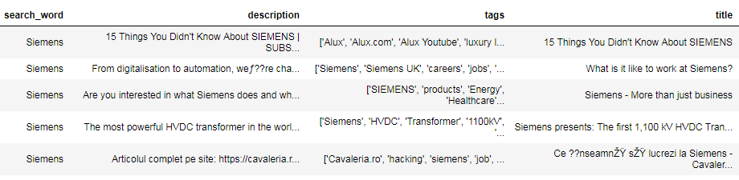
Text Preprocessing
Studied and then removed redundant data
Created new dataframe to apply count and density based features
word, character, istitle(first letter capitalized), punctuation, upper case, stop words
Final Text Data
Final Kept Data for BoW Model

Slide 11
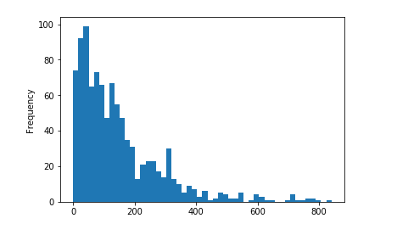
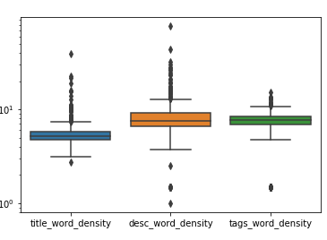
Text EDA (Few Examples)
Description Word count distribution:
Observe most descriptions have under 200 words
Word Density comparison between, title, description, tags:
Title has shorter words– perhaps due to character limitation

Slide 12
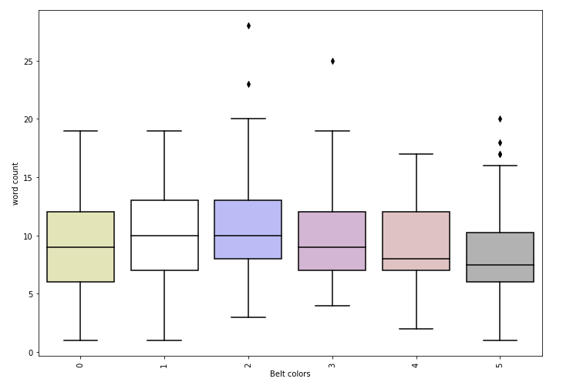
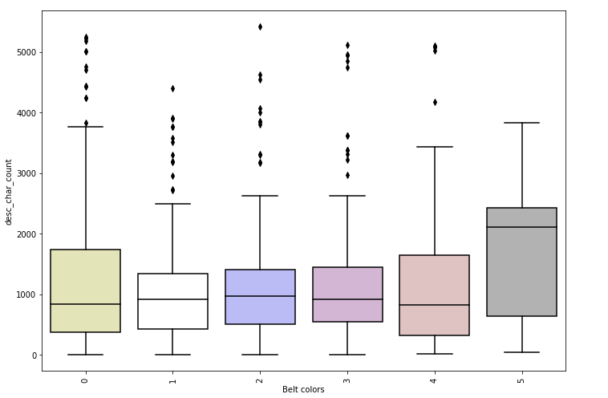
Text EDA (Continued – few more examples of interesting features)
Word Count in Title vs. Belt Color
Description Word Count vs. Belt Color

Slide 13
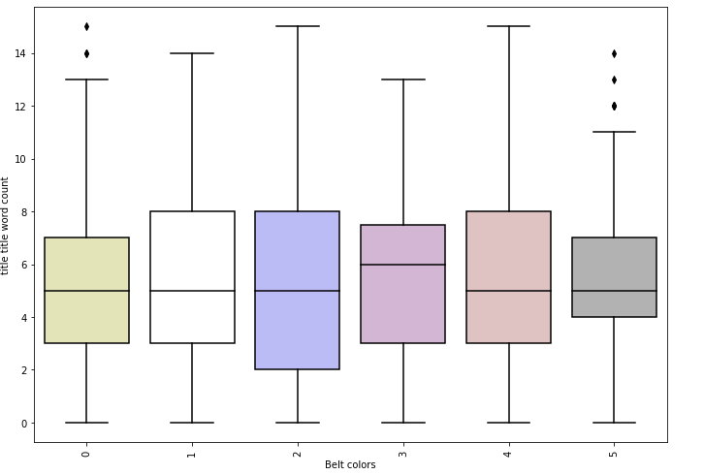
Text EDA (Example of discarded feature)
Count of words in title that have uppercase first letter

Slide 14
Count and Density Based Feature Summary
Count Based Features of Text Data | Brief Description | Notes:
title_char_count | # of characters in title | black belts have fewer chars
title_word_count | # of words in title | black belt videos have fewer words
title_word_density | character count / word count + 1 | Disregard
title_punctuation_count | # of punctuations in title | black belt videos have punctuations
title_title_word_count | # of words that have first letter capitalized | Disregard
title_upper_case_word_count | # of words that are completely capitilized | Upside down parabola
title_stopwords_count | # of stop words in title | black belt video titles have lowest stop word avg
desc_char_count | # of characters in description | black belt videos have highest description char count avg
desc_word_count | # of words in description | black belt videos have highest description word count avg and no outliers
desc_word_density | character count / word count + 1 | black belt videos have smallest range
desc_punctuation_count | # of punctuations in title | black belt videos have highest punctuation count
desc_title_word_count | # of words that have first letter capitalized | black belt videos have highest average words for first letter capitalized in desc
desc_upper_case_word_count | # of words that are completely capitilized | black belt videos have fewer completely upper case description words
desc_stopwords_count | # of stop words in description | black belt videos have MORE stop words on average inside description
tags_char_count | # of characters in tags | black belt videos have higher average for character tags count
tags_word_count | # of words in tags | black belt videos have higher average for # of words
tags_word_density | character count / word count + 1 | black belt videos have slightly higher word density average with a smaller range
tags_punctuation_count | # of punctuations in tags | black belt videos have slightly higher average for punctuation count in tags
tags_title_word_count | # of words that have first letter capitalized | Disregard
tags_upper_case_word_count | # of words that are completely capitilized | black belt videos have fewer completely upper case tags
tags_stopwords_count | # of stop words in tags | Upside down parabola

Slide 15
Text Modeling Results
NLP Features | Model | Notes | Accuracy
Train W2V Scratch, MeanEmbeddingVectorizer, unstemmed | Log Reg |  | 0.303
BoW TFIDF | Random Forest( n_estimators=100, max_depth=5 |  | 0.3131
Train W2V Scratch, TFIDFEmbeddingVectorizer, unstemmed | Log Reg |  | 0.3131
1-2 gram, TFIDF, stemmed, stop words | XGboost |  | 0.3232
Count and Density Based | Log Reg (C=1) |  | 0.3333
BoW, TFIDF | MNB |  | 0.3333
BoW, TFIDF | Stochastic Gradient Descent (loss='hinge', penalty='l2', alpha=1e-3, n_iter=5) | tested w/ n_iter, alpha, no changes | 0.3333
BoW, TFIDF | KNN (nn range 1-20) | no change based on nn | 0.3434
1-2, gram TFIDF, stop words | MNB |  | 0.3535
1-2 gram, TFIDF, stemmed, stop words | Log Reg |  | 0.3737
1-2 gram, TFIDF, stop words | XGBoost |  | 0.3737
BoW, TFIDF | XGBoost (objective ='multi:softmax', colsample_bytree = 0.3, learning_rate = 0.1, max_depth = 5, alpha = 10, n_estimators = 10) |  | 0.3838
1-2 gram, TFIDF, stemmed, stop words | XGBoost |  | 0.3838
BoW TFIDF | Random Forest - random search | {'n_estimators': [200, 400, 600, 800, 1000, 1200, 1400, 1600, 1800, 2000], 'max_features': ['auto', 'sqrt'], 'max_depth': [10, 20, 30, 40, 50, 60, 70, 80, 90, 100, 110, None], 'min_samples_split': [2, 5, 10], 'min_samples_leaf': [1, 2, 4], 'bootstrap': [True, False]} | 0.3992
BoW, TFIDF | Log Reg |  | 0.404
BoW, CountVectorizer | Log Reg | Same results as TFIDF because TFIDF is weighted with Log(N/n) | 0.404
1-2 gram TFIDF, stop words | Log Reg |  | 0.404
1-2 gram, TFIDF, stemmed, stop words | Log Reg |  | 0.404
1-2 gram, TFIDF, stemmed, stop words | Random Forest |  | 0.4242

Slide 16
Final Model: Numeric + Text Data
NLP Features | Model | Notes / Parameters | Accuracy | Average Weighted F1 Score
Count features, BoW, CountVectorizer | OneVsrest(Log Reg) |  | 0.4678 | 0.4386
Count features, BoW, CountVectorizer | Random Forest |  | 0.4355 | 0.38621
Count features, BoW TFIDF | Stochastic Gradient Descent (loss='hinge', penalty='l2', alpha=1e-3, n_iter=5, ) |  | 0.2621 | 0.1958
Count features, BoW TFIDFVectorizer | Random Forest - Default |  | 0.4516 | 0.4018
Count features, BoW TfidfVectorizer(1-2 gram, stop words) | KNN (nn =11) |  | 0.5323 | 0.5234
Count features, BoW TfidfVectorizer(1-2 gram, stop words) | XGBoost(objective ='multi:softmax', colsample_bytree = 0.3, learning_rate = 0.1, max_depth = 5, alpha = 10, n_estimators = 10) |  | 0.7581 | 0.7711
Count features, BoW TfidfVectorizer | XGBoost(learning_rate =0.1, n_estimators=1000, max_depth=5, min_child_weight=1, gamma=0, subsample=0.8, colsample_bytree=0.8, objective= 'binary:logistic', nthread=4, scale_pos_weight=1,seed=27) | increasing number of estimators to 1000 helped | 0.8145 | 0.8146
Count features, BoW TfidfVectorizer(1-2 gram, stop words) | XGBoost Grid Search Tuned params | Grid Search ((xgb__max_depth': 3, 'xgb__min_child_weight': 1)) | 0.8064 | 0.806
Count features, BoW TfidfVectorizer(1-2 gram, stop words) | Gradient Boosting Classifier | Random Search (n_estimators = [100, 500, 900, 1100, 1500] max_depth = [2, 3, 5, 10, 15] min_samples_leaf = [1, 2, 4, 6, 8] min_samples_split = [2, 4, 6, 10] max_features = ['auto', 'sqrt', 'log2', None]) | 0.8387 | 0.8417
Count features, BoW TfidfVectorizer(1-2 gram, stop words) | Gradient Boosting (default) |  | 0.8548 | 0.8596

Slide 17
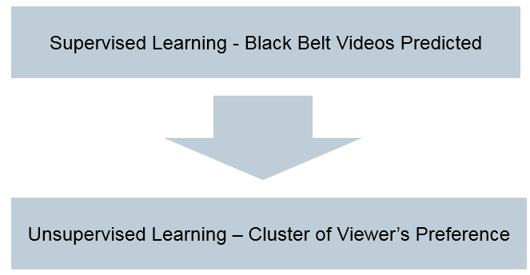
Conclusion / Next Steps
Obtain additional random data from Youtube API to improve performance and W2V models
Consider external sources that could cause virality scraped on the internet
Model stacking - Feed the outcome of this model to an unsupervised learning problem which clusters of black belt videos are sent to user feeds.

